Slide 1


Computer-Aided Design Sequential Circuits
Mahdi Aminian
Some slides courtesy of:
“Hardware Systems Modeling”, A. Vachoux, EPFL
CAD slides from Dr. Saheb Zamani

Slide 2
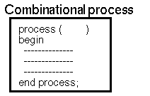
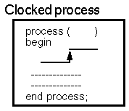


RTL Style
در RTL مدار ترتيبي به دو بخش (تركيبي و عناصر حافظه) تقسيم مي شود.
مي توان براي هر بخش يك پروسس نوشت يا براي هر دو فقط يك پروسس نوشت.

Slide 3




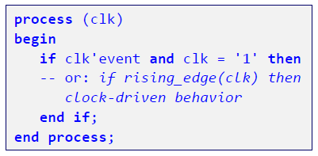
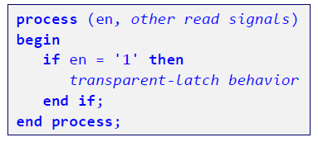
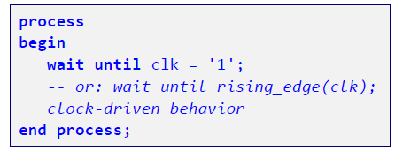
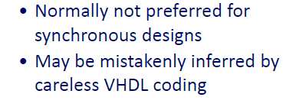

Describing Sequential/Synchronous Behavior

Slide 4
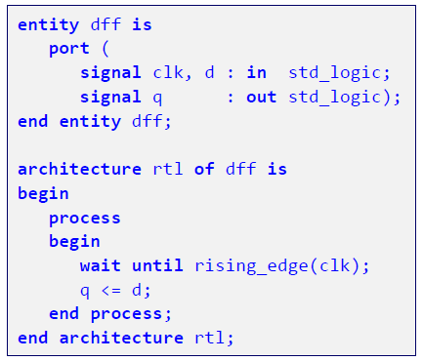
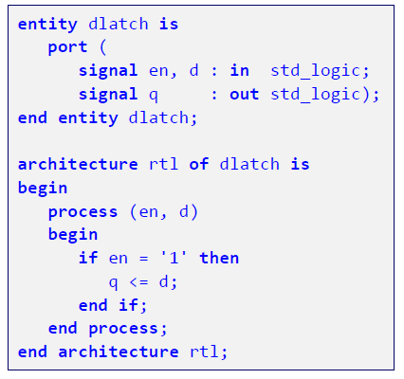
Flip-Flop vs. Latch Models

Slide 5
Description of Rising Clock Edge for Synthesis
براي عناصرحافظه: if يا wait until به صورت خاص
Standard for synthesis: IEEE 1076.6
... if condition
RISING_EDGE (CLK) (not always supported)
CLK‘event and CLK='1‘
CLK='1' and CLK‘event
not CLK‘stable and CLK='1‘
CLK='1' and NOT CLK‘stable
... wait until condition
RISING_EDGE (CLK)
CLK‘event and CLK='1‘
CLK='1' and CLK‘event
not CLK‘stable and CLK='1‘
CLK='1' and not CLK‘stable
CLK='1'

Slide 6
Rising_edge (falling_edge)
In Std_Logic_1164 package
process begin wait until RISING_EDGE(CLK); Q <= D; end process;
function RISING_EDGE (signal CLK : std_ulogic) return boolean is begin if ( CLK`event and CLK =`1` and CLK`last_value=`0`) then return true; else return false; end if; end RISING_EDGE;

Slide 7
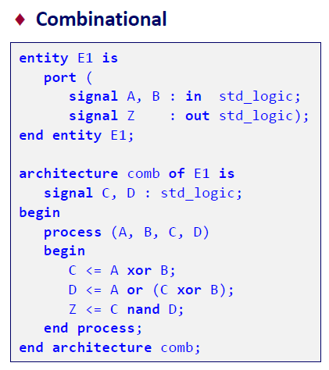
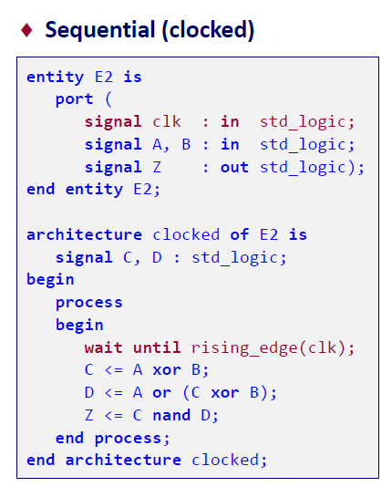
From Combinational to Sequential Logic

Slide 8

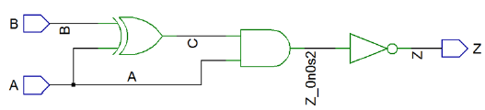
From Combinational to Sequential Logic

Slide 9

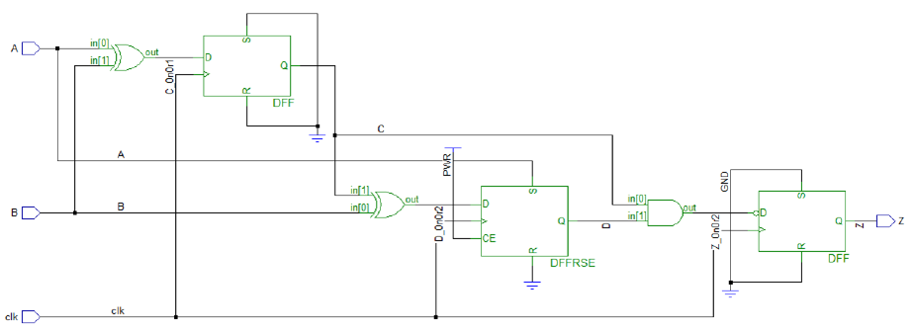
From Combinational to Sequential Logic

Slide 10
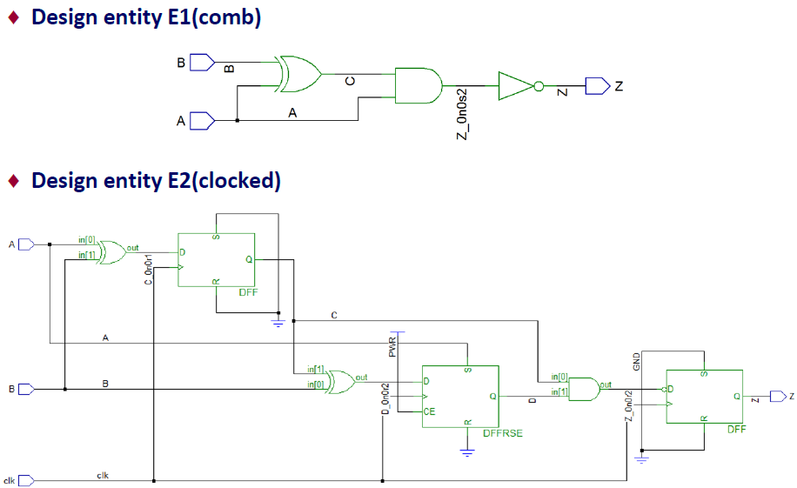
From Combinational to Sequential Logic

Slide 11
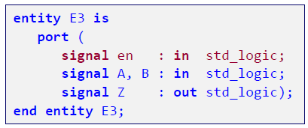
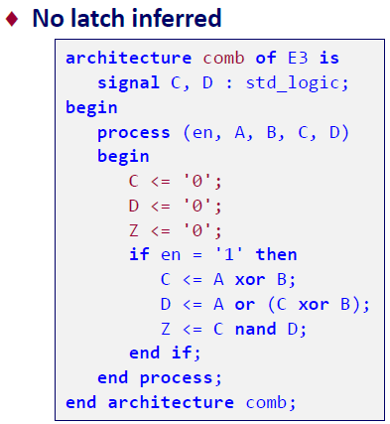
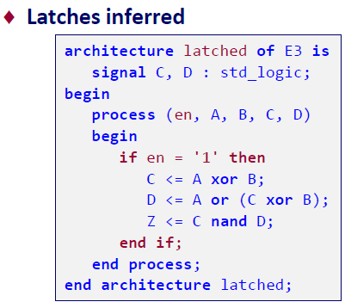
Avoid Latches

Slide 12
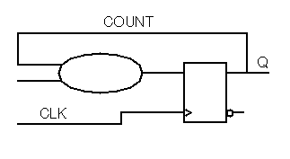
Register Inference
Library IEEE; use IEEE.Std_Logic_1164.all; entity COUNTER is port ( CLK : in std_ulogic; Q : out integer range 0 to 15 ); end COUNTER; architecture A of COUNTER is signal COUNT : integer range 0 to 15 ; begin process (CLK) begin if CLK`event and CLK = `1` then if (COUNT >= 9) then COUNT <= 0; else COUNT <= COUNT +1; end if; end if; end process; Q <= COUNT; end A;
One-digit BCD counter
For all signals which receive an assignment in clocked processes, memory is synthesized.
COUNT: 4 FF
(constrained integer)
Q not used in clocked process.
Problem: doesn’t have power-on reset

Slide 13
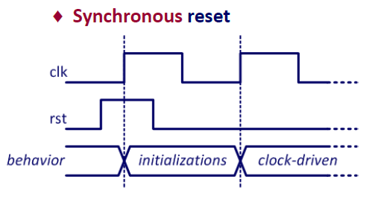
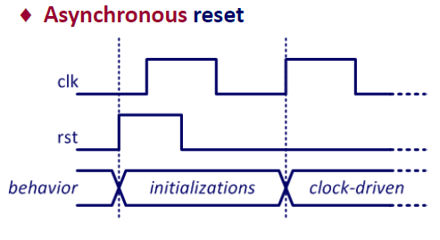
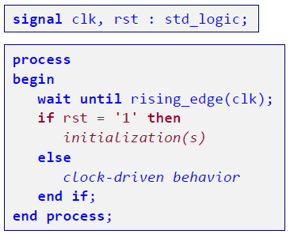
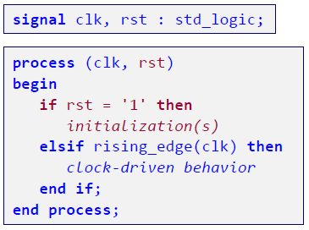
Reset for Edge-Sensitive Behavior

Slide 14
Asynchronous Set/Reset
Library IEEE; use IEEE.Std_Logic_1164.all; entity ASYNC_FF is port ( D, CLK, SET, RST : in std_ulogic; Q : out std_ulogic); end ASYNC_FF; architecture A of ASYNC_FF is begin process (CLK, RST, SET) begin if (RST = `1`) then Q <= `0`; elsif SET ='1' then Q <= '1'; elsif (CLK`event and CLK = `1`) then Q <= D; end if; end process; end A;
if/elsif - structure
The last elsif has an edge
No else
براي set/reset سنكرون فقط clk در ليست حساسيت قرار مي گيرد (مي توان با wait until هم مدلسازي كرد).
اما براي آسنكرون فقط با ليست حساسيت مي توان مدلسازي كرد
حتماً همة وروديهاي آسنكرون در ليست حساسيت وارد شوند والا نتيجة شبيه سازي با سنتز متفاوت مي شود.

Slide 15
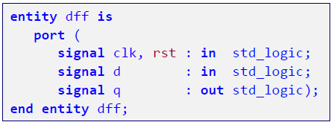
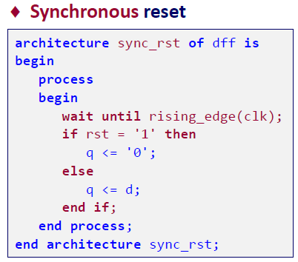
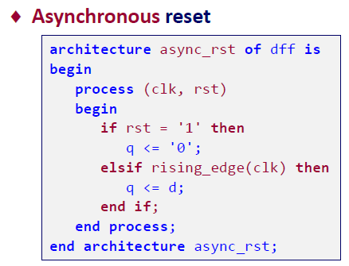
Example: D Flip-Flop with Reset

Slide 16
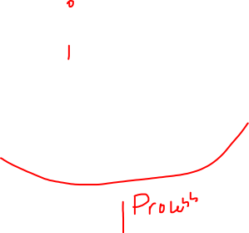
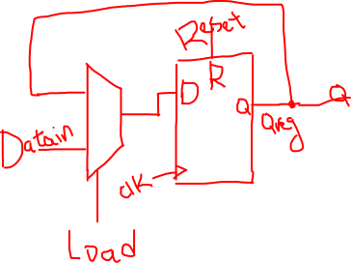
1-bit Register (with 1 Process)
Library IEEE; use IEEE.Std_Logic_1164.all; entity Register_1bit is port ( CLK, Reset, Load : in std_logic;
DataIN : in std_logic; Q : out std_logic ); end Register_1bit; architecture RTL of Register_1bit is signal Q_Reg : std_logic ; begin process (CLK, Reset) begin
if (Reset = ‘1’) then
Q_Reg <= ‘0’; elsif CLK’event and CLK = `1` then
if (Load = ‘1’) then
Q_Reg <= DataIN; else
Q_Reg <= Q_Reg; end if;
end if;
end process;
Q <= Q_Reg;

Slide 17
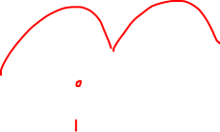
1-bit Register (with 2 Processes)
Library IEEE; use IEEE.Std_Logic_1164.all; entity Register_1bit is port ( CLK, Reset, Load : in std_logic;
DataIN : in std_logic; Q : out std_logic ); end Register_1bit; architecture RTL of Register_1bit is signal Reg_Input, Q_Reg : std_logic ; begin process (CLK, Reset) begin
if (Reset = ‘1’) then
Q_Reg <= ‘0’; elsif CLK’event and CLK = `1` then Q_Reg <= Reg_Input;
end if; end process;
process (Load, Q_Reg, DataIN) begin
if (Load = ‘1’) then
Reg_Input <= DataIN; else
Reg_Input <= Q_Reg; end if; end process;
Q <= Q_Reg;
end RTL;

Slide 18
1-bit Register -> 4-bit Register
Library IEEE; use IEEE.Std_Logic_1164.all; entity Register_1bit is port ( CLK, Reset, Load : in std_logic;
DataIN : in std_logic_vector (3 downto 0); Q : out std_logic_vector (3 downto 0) ); end Register_1bit; architecture RTL of Register_1bit is signal Reg_Input, Q_Reg : std_logic_vector (3 downto 0) ; begin process (CLK, Reset) begin
if (Reset = ‘1’) then
Q_Reg <= (others => ‘0’); elsif CLK’event and CLK = `1` then Q_Reg <= Reg_Input;
end if; end process;
process (Load, Q_Reg, DataIN) begin
if (Load = ‘1’) then
Reg_Input <= DataIN; else
Reg_Input <= Q_Reg; end if; end process;
Q <= Q_Reg;
end RTL;

Slide 19
4-bit Shift-Register
??

